Slide 1
Lean Methodology

Slide 2
Lean Methodology
Lean methodology originally sprouted in Japan at Toyota Production System.
Now it has made its way into businesses, workplaces, and other knowledge-driven settings around the world.
As Jim Benson of Modus Cooperandi said, “Lean is both a philosophy and a discipline which, at its core, increases access to information to ensure responsible decision making in the service of creating customer value.”

Slide 3

Lean thinkers who brought the methodology from Japan to the West (specifically James Womack and Daniel Jones) specified five core principles:
Value: Understand what customers value in a product or service
Value Stream: What goes into maximizing value and eliminating waste throughout the entire process from design to production
Flow: All product processes flow and synchronizes seamlessly with each other
Pull: Flow is made possible by “pull,” or the idea that nothing is made before it is needed, thereby creating shorter delivery cycles
Perfection: Relentlessly pursue perfection by constantly engaging the problem-solving process
The idea is to refine internal processes as much as possible to give consumers the highest value possible in a product or service. Anything that doesn’t contribute to the product’s value to the customer is considered inefficient.

Slide 4

Another key to lean is its definition of waste, of which there are eight types:
Motion: Unnecessary movement of people or processes (equipment and manufacturing machinery, for example). Repetitive movements that do not add value translates to wasted time and resources.
Over-processing: Doing unnecessary processes or steps than what is required to create a valuable product.
Extra-processing: Products require more work or quality than necessary to deliver value to the customer.
Defects: Manufacturing processes create defective products — which becomes wasted materials.
Transport: Like motion, but over greater distances to include the transport of tools, inventory, people, or products further than necessary.
Human Potential: Underused skills and talent due to poor employee management and team structure lead to a lack of morale and productivity.
Waiting: Idle equipment and waiting on materials or equipment can slow down processes and efficiency.
Inventory: Excessive products and inventory take up space, reveal overproduction, and create backwork.
It’s easy to see how continuous improvement is always possible and includes every level of the business, from talent management, manufacturing, IT, marketing, and more.

Slide 5
What Makes the Lean Methodology Unique?
Although maximizing efficiency may seem like a universal value, lean methodology is unique because it begins with the customer in mind.
Rather than maximizing the bottom line for the sake of doing so, lean methodology is a paradigm for ensuring that customer value is a top consideration at every step of the process.
However, This doesn’t mean that employee satisfaction and well-being are not valuable. Nor does it assume that production efficiency is more important than humans.
Processes that create burnout, exhaustion, or fuel disharmony between people or levels of the business are just as problematic, if not more so, than a defective piece of equipment.
Lean encourages leaders to consider a holistic picture of efficiency, with people and outcomes at the center.
What was in demand yesterday might not be valued tomorrow.
Lean methodology creates a framework for constant adaptation to ever-changing standards for you, your business, and your products/services.

Slide 6
What Makes the Lean Methodology Unique?
Although maximizing efficiency may seem like a universal value, lean methodology is unique because it begins with the customer in mind.
Rather than maximizing the bottom line for the sake of doing so, lean methodology is a paradigm for ensuring that customer value is a top consideration at every step of the process.
However, This doesn’t mean that employee satisfaction and well-being are not valuable. Nor does it assume that production efficiency is more important than humans.
Processes that create burnout, exhaustion, or fuel disharmony between people or levels of the business are just as problematic, if not more so, than a defective piece of equipment.
Lean encourages leaders to consider a holistic picture of efficiency, with people and outcomes at the center.
What was in demand yesterday might not be valued tomorrow.
Lean methodology creates a framework for constant adaptation to ever-changing standards for you, your business, and your products/services.

Slide 7
Lean Methodology Examples
Other examples of lean in action have yielded unexpected results.
When Nike implemented a lean approach, they not only experienced less waste, but they also noticed an uptick in worker protections and improved labor practices.
Other studies show that lean management can reduce the “serious” and “critical” labor violations by almost 15 percentage points in certain areas of the global supply chain.
These efforts show that lean values employee safety and well-being more than some traditional management practices. Ultimately, the framework benefits companies as a whole.
Another area where continuous improvement can enhance operations is in commercial aviation. Consider how much idle time and arcane processes are typical when dealing with airlines and airports.
McKinsey notes that after adopting lean techniques, airline operations can reduce turnaround time for flights drastically with a few simple changes.
McKinsey also found that lean methods can improve airline maintenance by 30 to 50 percent.
Lean is vital for an industry like aviation, where there is always room to improve customer value by changing processes to streamline operations and enhance customer experiences.

Slide 8

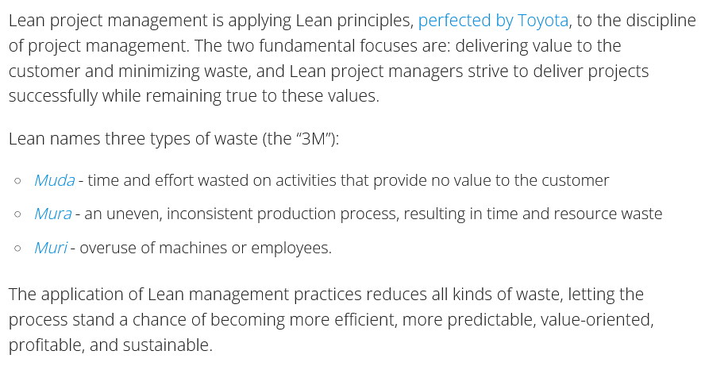

Slide 9
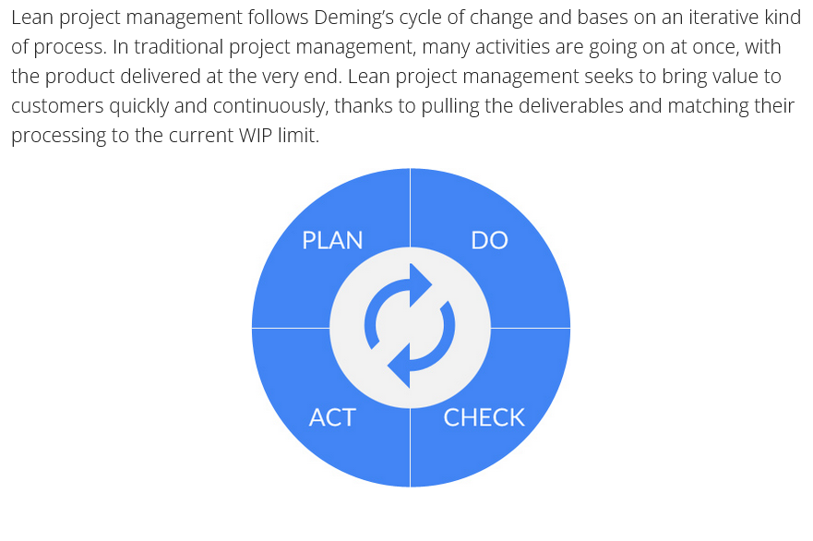

Slide 10
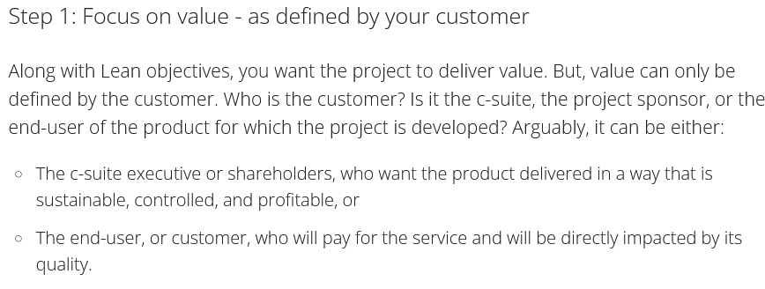
Steps : For Lean Development

Slide 11

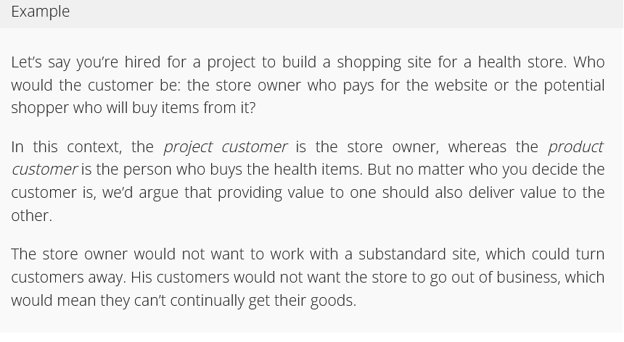

Slide 12
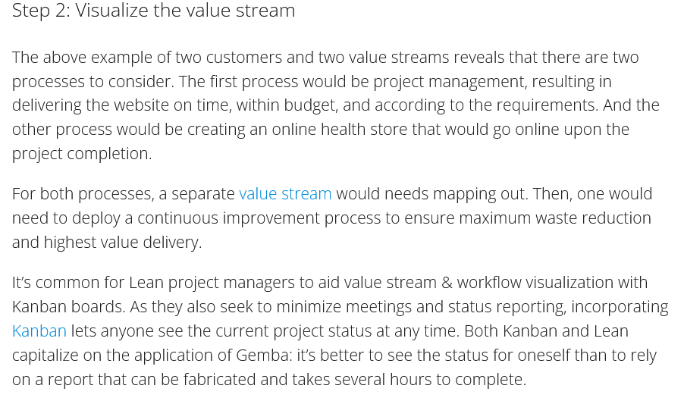

Slide 13
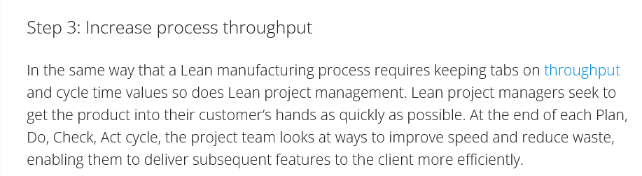

Slide 14
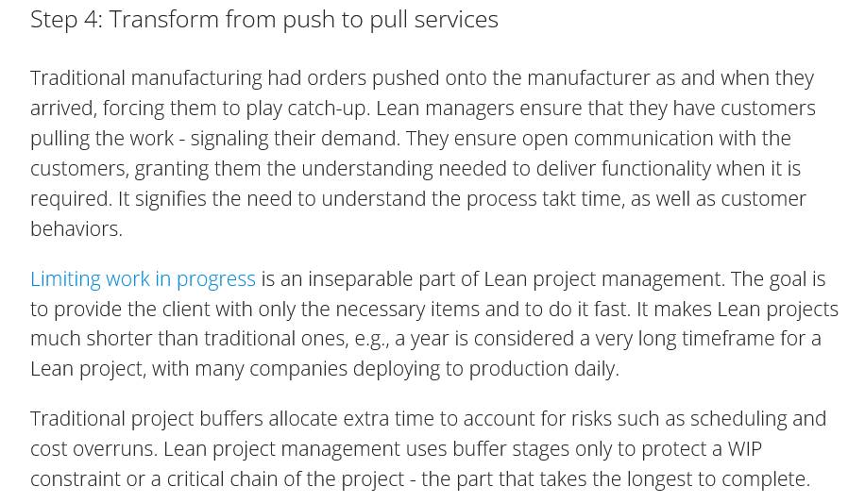

Slide 15
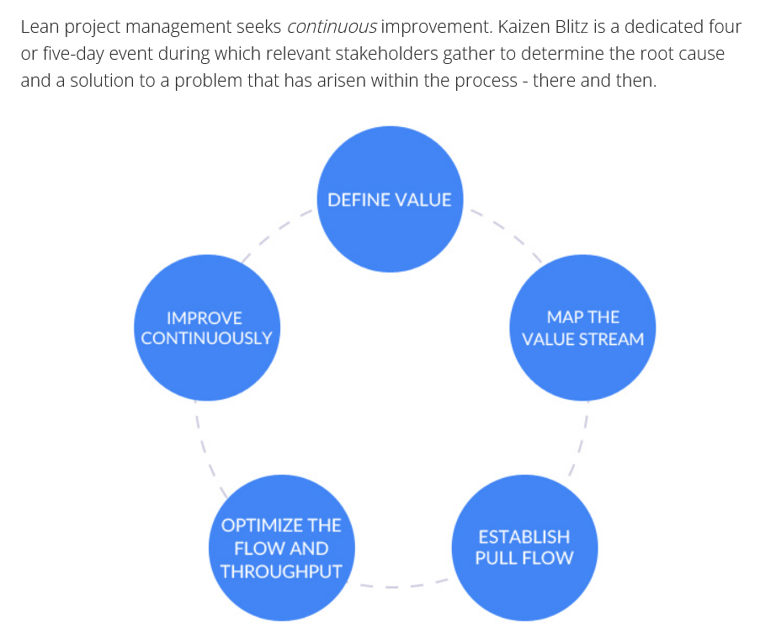
Step 5 : Continuous Improvement

Slide 16
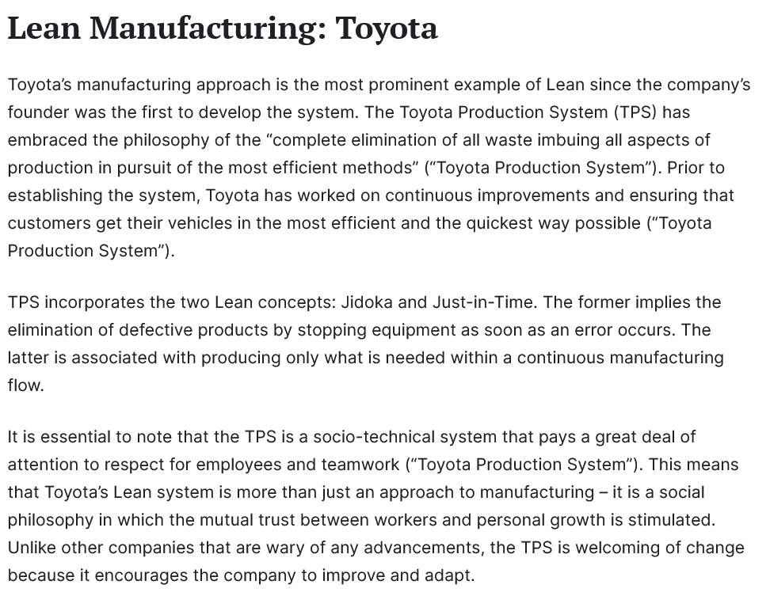
Case Study : Toyota

Slide 17
Case Study : Toyota

Slide 18
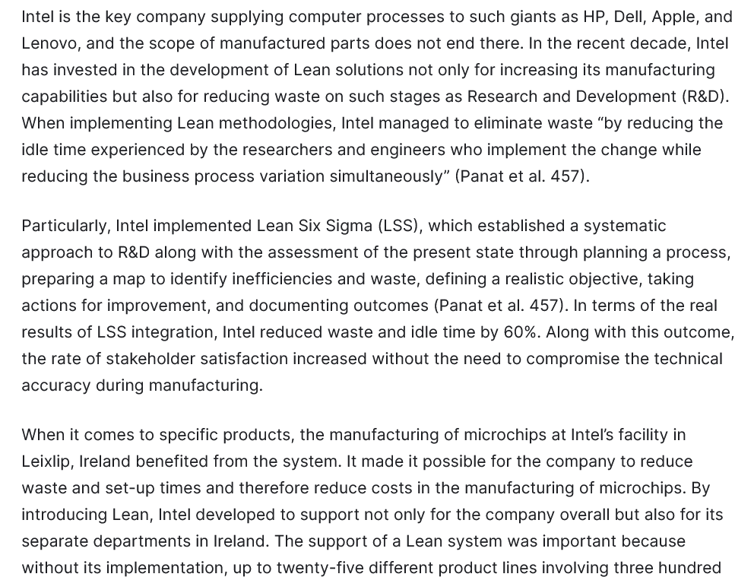
Case Study :Intel

Slide 19
Case Study :Intel

Slide 20
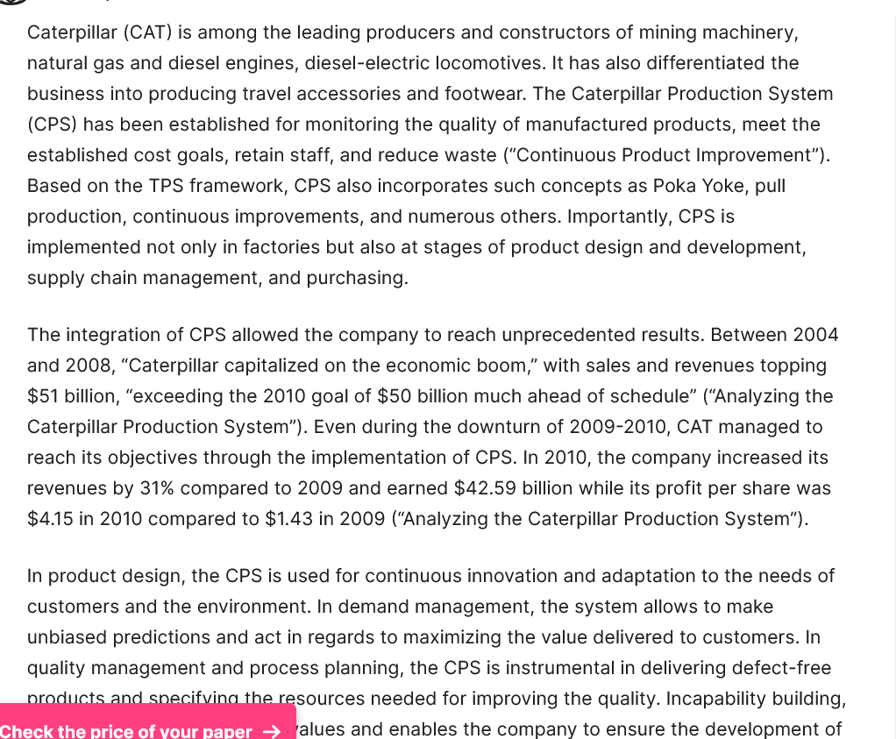
Case Study : Caterpillar

Slide 21
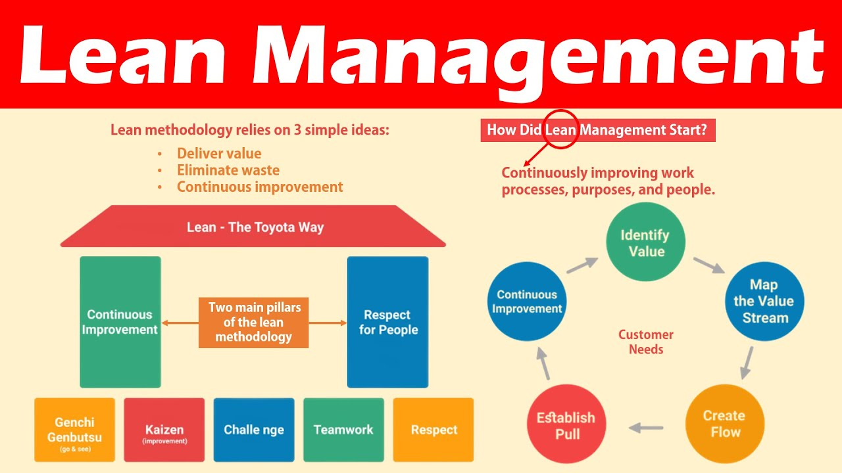

Slide 22
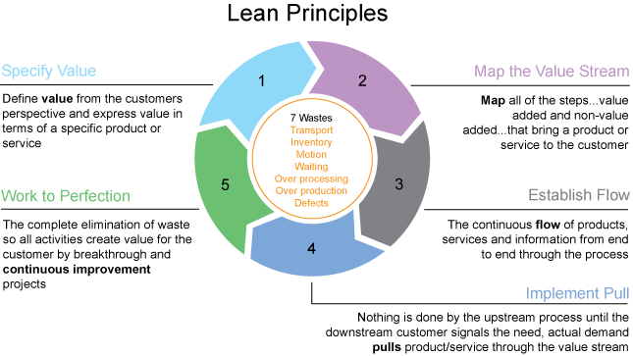

Slide 23
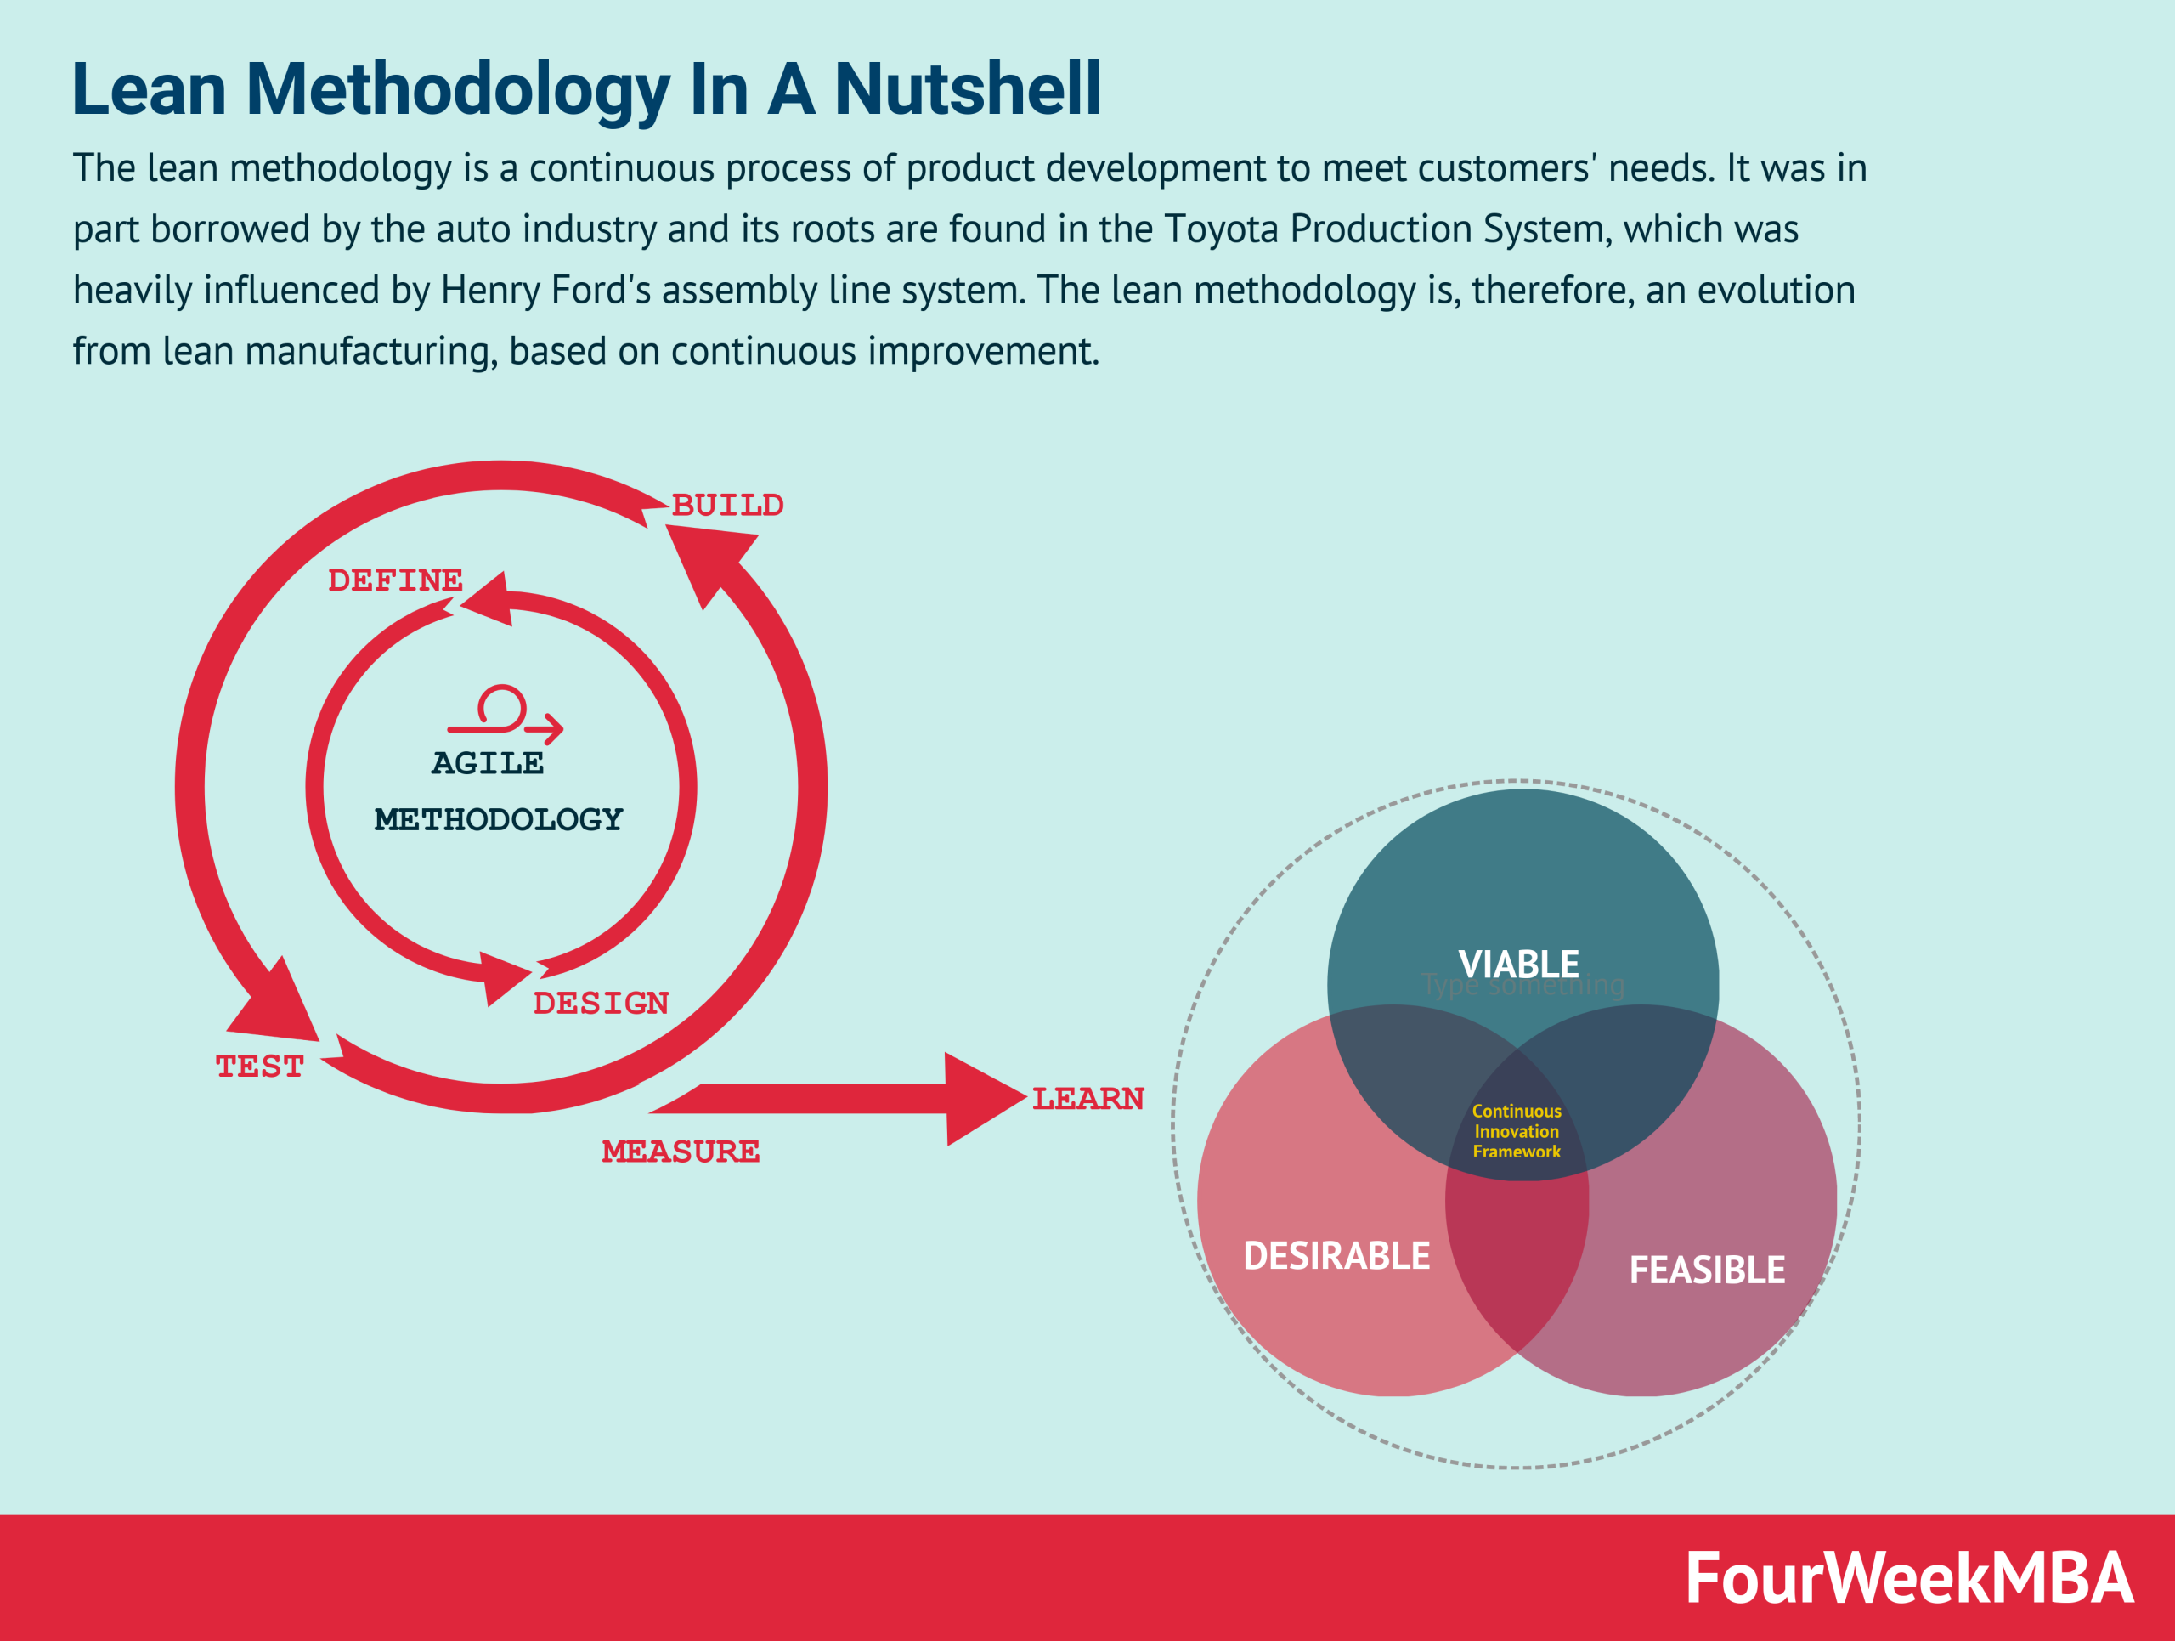

Slide 24
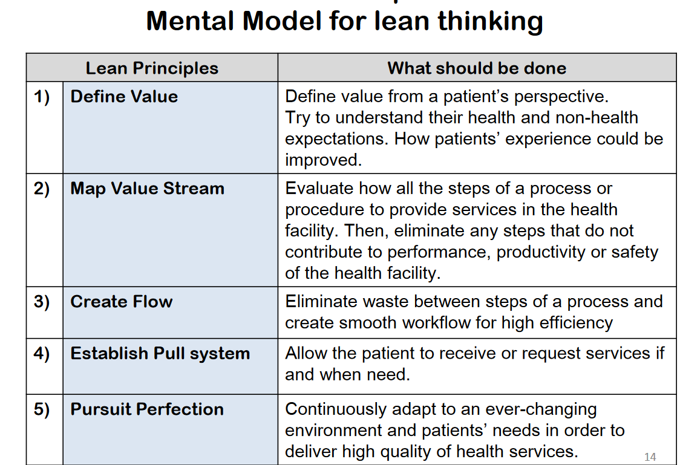

Slide 25
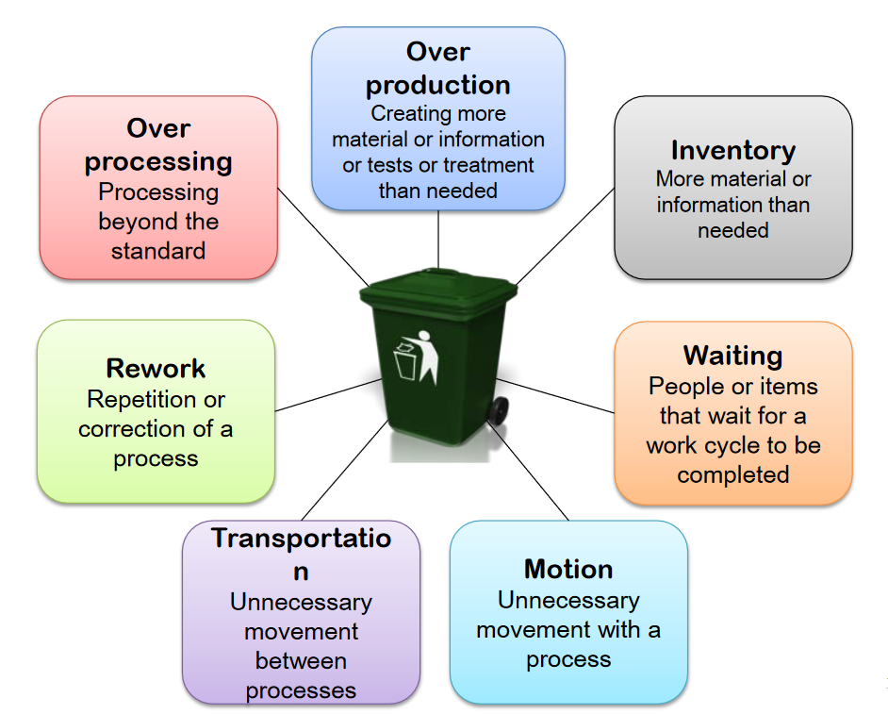

Slide 26
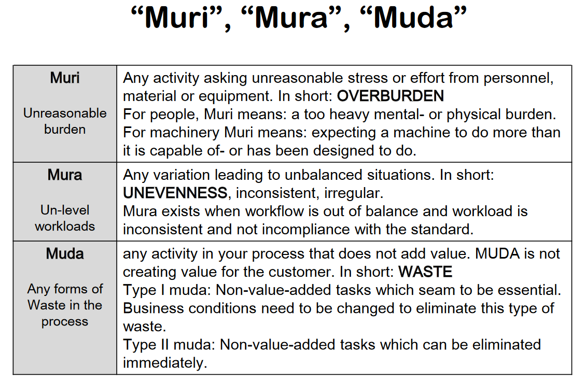

Slide 27
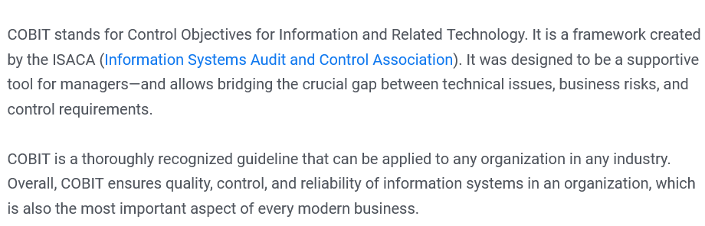
COBIT

Slide 28
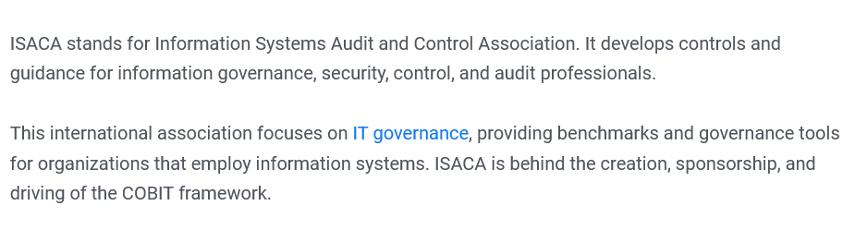
ISACA

Slide 29
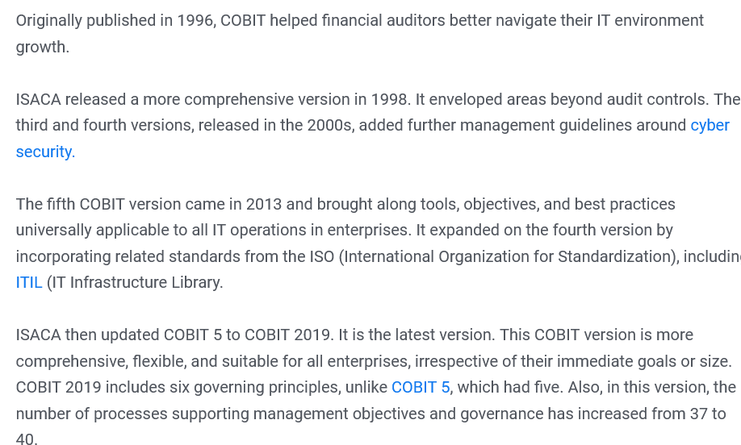
History

Slide 30
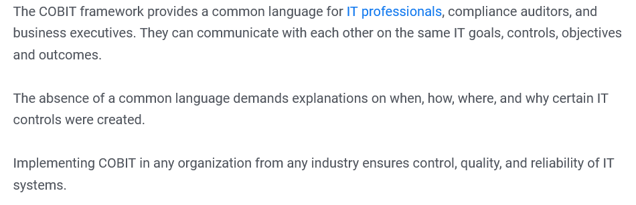
Importance

Slide 31
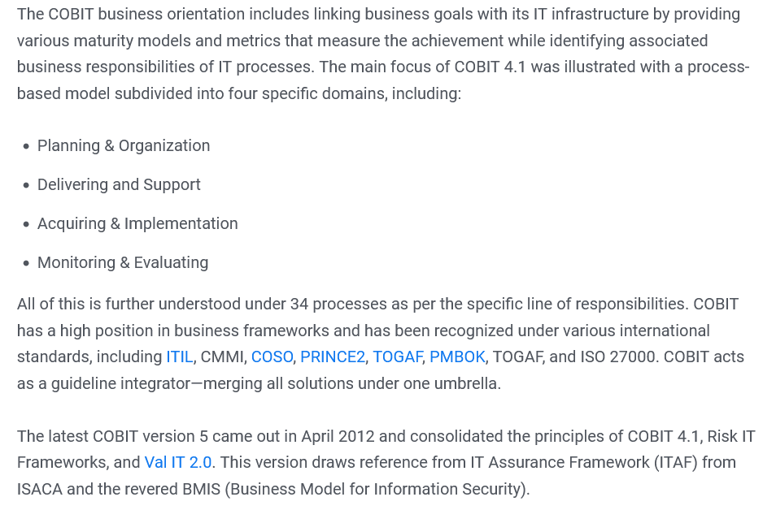
Framework of COBIT

Slide 32

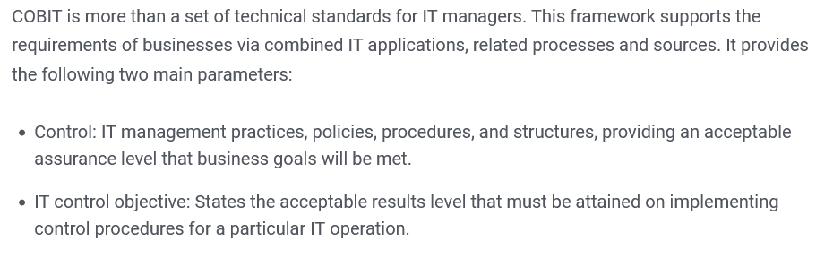

Slide 33
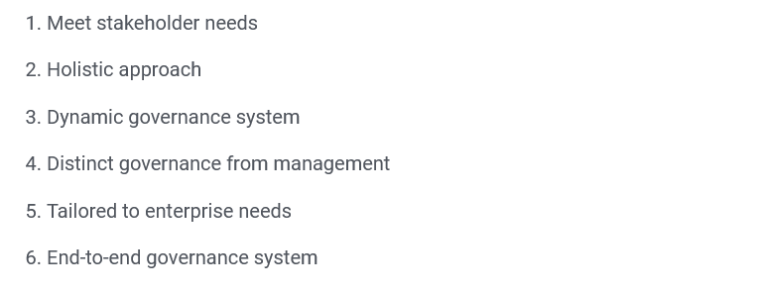
Principles of COBIT

Slide 34
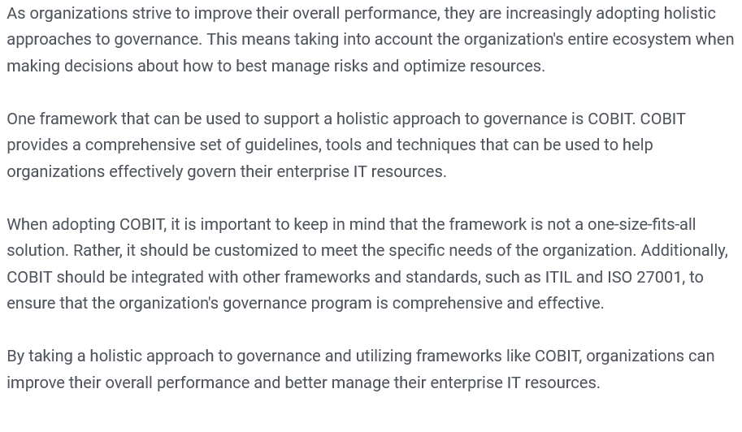
Holistic Approach To Governance

Slide 35
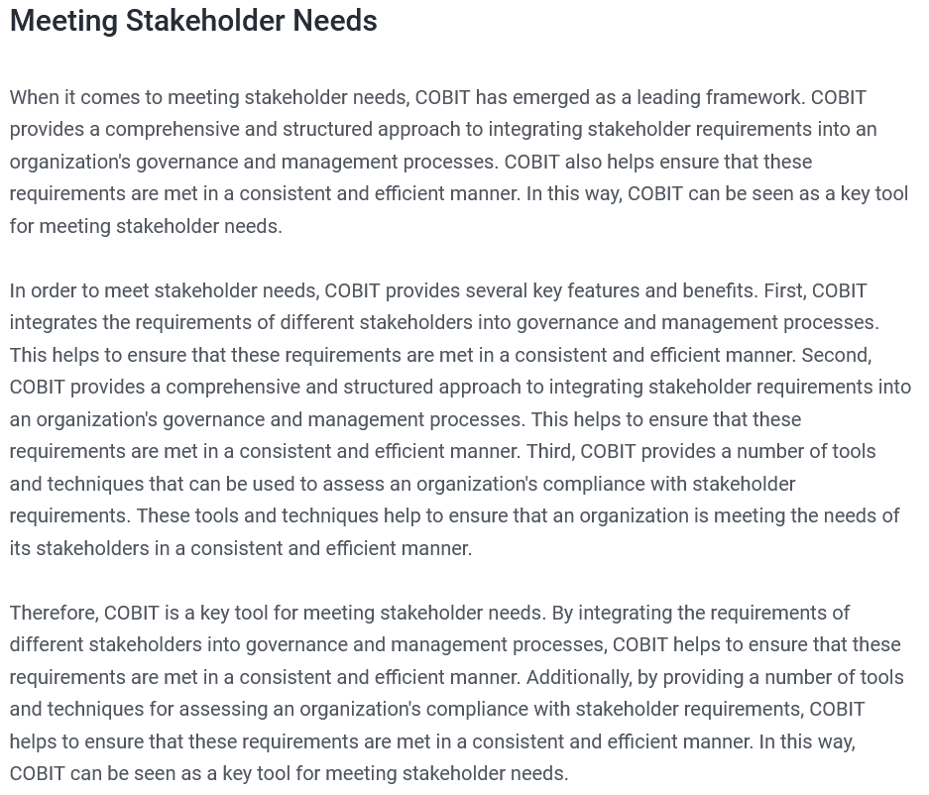
Meeting Stake Holders Needs

Slide 36
Meeting Stake Holders Needs

Slide 37
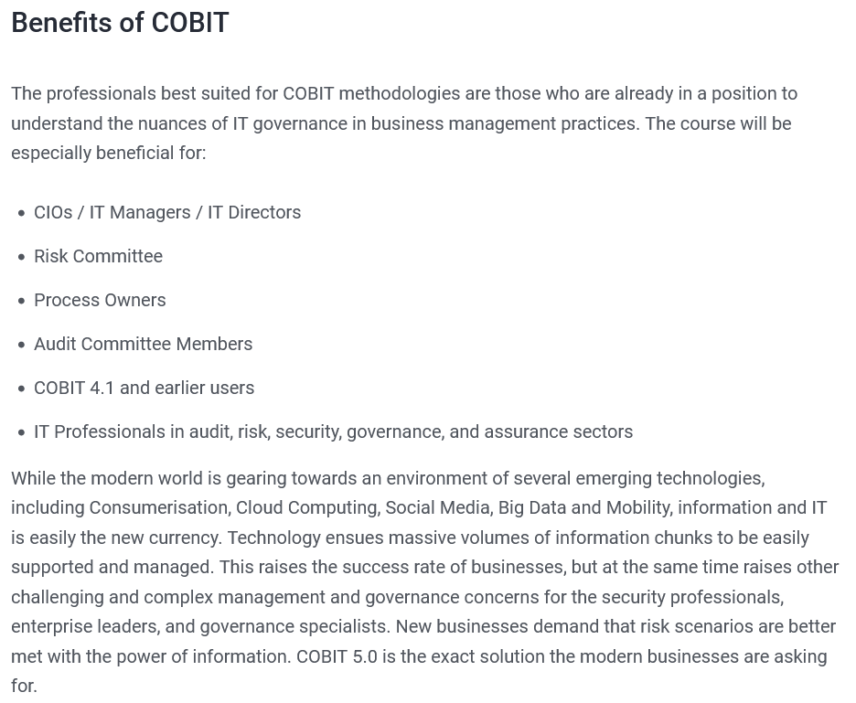
Benefits of COBIT

Slide 38
Benefits of COBIT

Slide 39
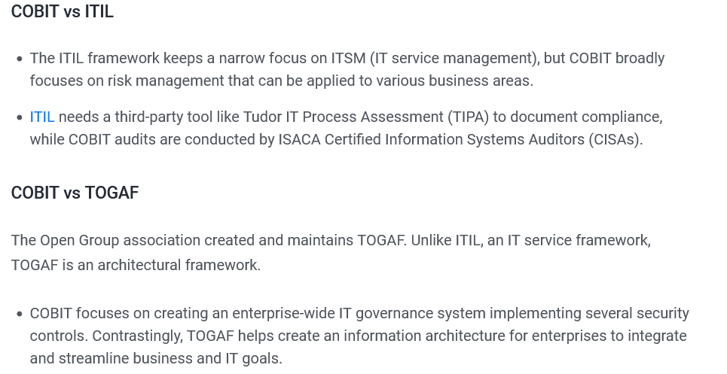
Key Differences

Slide 40
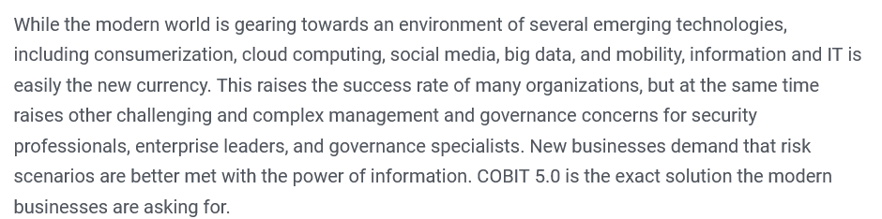
Key Points : Conclusion

Slide 41
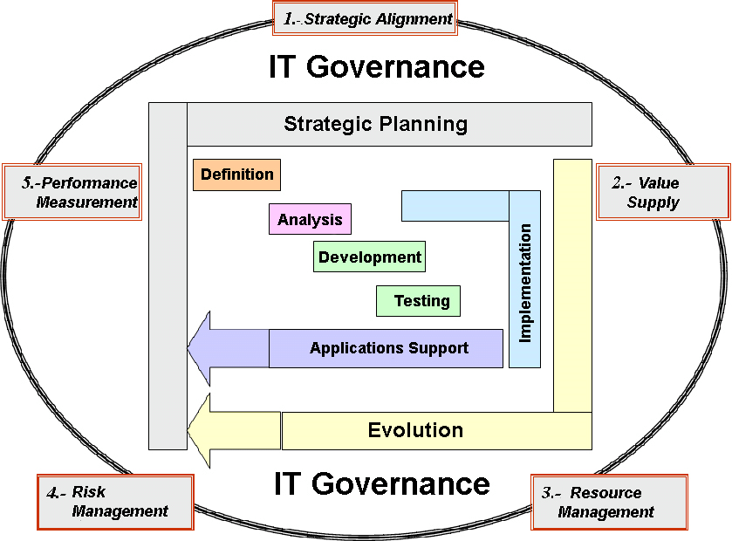

Slide 42
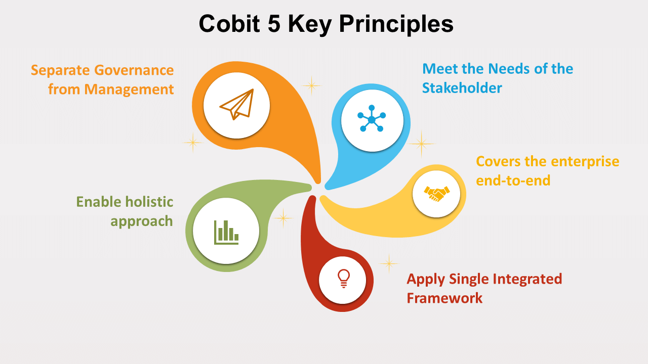

Slide 43
